Slide 1
An Overview of Machine Learning

Slide 2
Outline & Content
What is machine learning?
Learning system model
Algorithms
Machine learning methods
Who’s using it
Applications

Slide 3
What is machine learning?
Machine learning is a type of artificial intelligence (AI) that provides computers with the ability to learn without being explicitly programmed.
A branch of artificial intelligence, concerned with the design and development of algorithms that allow computers to evolve behaviors based on empirical data.
As intelligence requires knowledge, it is necessary for the computers to acquire knowledge.

Slide 4
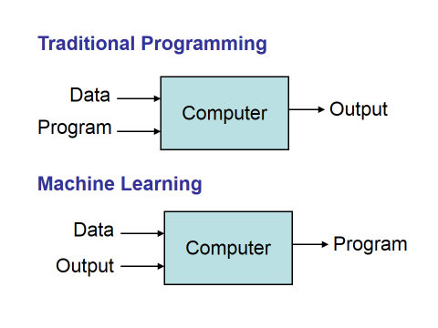
Learning system model

Slide 5
Algorithms
The success of machine learning system also depends on the algorithms.
The algorithms control the search to find and build the knowledge structures.
The learning algorithms should extract useful information from training examples.

Slide 6
Machine learning methods
Supervised (inductive) learning
Training data includes desired outputs
Unsupervised learning
Training data does not include desired outputs
Semi-supervised learning
Training data includes a few desired outputs
Early examples of this include identifying a person's face on a web cam.
Reinforcement learning
Rewards from sequence of actions

Slide 7
Diagrams
Supervised learning
Unsupervised learning
Semi-supervised learning

Slide 8
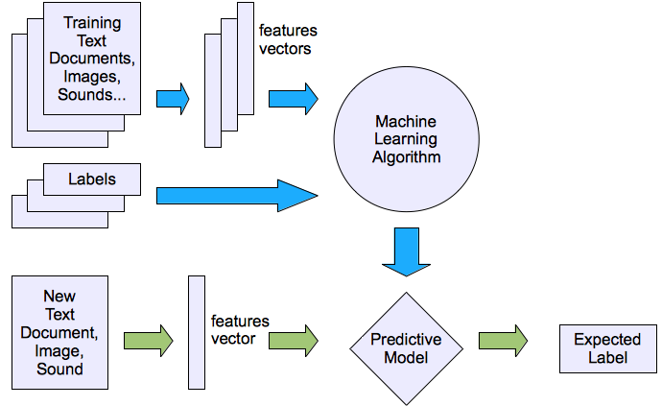
Machine learning structure
Supervised learning

Slide 9
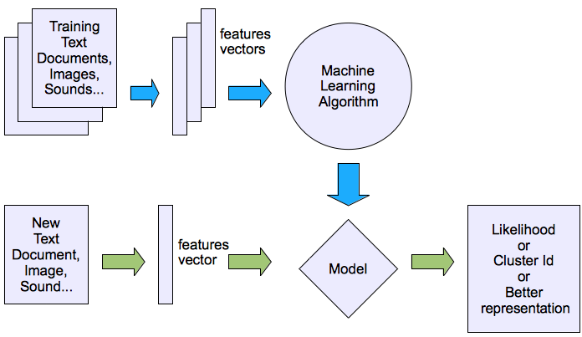
Machine learning structure
Unsupervised learning

Slide 10
Who’s using it
Financial services
Government
Oil and gas
Health care
Marketing & sales
Transportation

Slide 11
Applications
Face detection
Weather prediction
Spam filtering
Topic spotting
Fraud detection
Medical diagnosis
Customer segmentation

Slide 12
Thank You !!!!!!

